Slide 1

Logic Apps
Anuraj P
MVP, Architect Product Engineering SOCXO

Slide 2


App Service
Web Apps
Mobile Apps
Web apps that scale with your business
Build Mobile apps for any device
LOGIC Apps
Api Apps
Automate business process across SaaS and on-premises
Easily build and consume APIs in the cloud
Notes:
Azure App Service is an integrated service that enables you to create web and mobile apps for any platform or device, easily integrate with SaaS solutions (Office 365, Dynamics CRM, Salesforce, Twilio, etc), easily connect with on-premises applications (SAP, Oracle, Siebel, etc), and easily automate businesses processes while meeting stringent security, reliability, and scalability needs.

Slide 3
New Logic Apps for easy automation
No code designer for rapid creation
Dozens of pre-built templates to get started
Out of box support for popular SaaS and on-premises apps
Use with custom API apps of your own
Biztalk APIs for expert integration scenarios
LOGIC Apps
Automate SaaS and
on-premises systems
Notes:
Logic Apps are part of Azure App Service. They allow users or developers to automate business process execution and workflow via an easy to use visual designer. For more control a developer may use the Logic App Workflow Definition Language to modify the runtime. Logic Apps are wired to easily consume API apps such as DropBox, SendGrid and more. Invoking a Logic App may be done programmatically, via triggers, or on a recurring basis.

Slide 4
All of the Azure-native capabilities you’d expect
Full audit logs of all management operations
Role-based access control
Deployment lifecycle with Resource Manager
Resource Management API + resource PowerShell
On-prem support with release of Azure Stack

Slide 5
Target audience is anyone who can use Azure
… but not necessarily business users or consumers

Slide 6
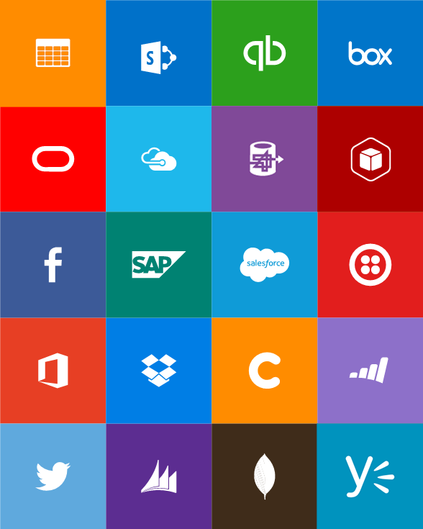
Built-in API Connectors
Connectors
Box
Chatter
Delay
Dropbox
Azure HD Insight
Marketo
Azure Media Services
OneDrive
SharePoint
SQL Server
Office 365
Oracle
QuickBooks
SalesForce
Sugar CRM
SAP
Azure Service Bus
Azure Storage
Timer / Recurrence
Twilio
Twitter
IBM DB2
Informix
Websphere MQ
Azure Web Jobs
Yammer
Dynamics CRM
Dynamics AX
Hybrid Connectivity
Protocols
BizTalk Services
HTTP, HTTPS
File
Flat File
FTP, SFTP
POP3/IMAP
SMTP
SOAP + WCF
Batching / Debatching
Validate
Extract (XPath)
Transform (+Mapper)
Convert (XML-JSON)
Convert (XML-FF)
X12
EDIFACT
AS2
TPMOM
Rules Engine

Slide 7
Demo
Email me if my website is down
Respond to a tweet

Slide 8
Developing Logic Apps with Visual Studio

Slide 9

Questions
and
Answers

Slide 10


